Slide 1
Section 11.4
The Hyperbola
Copyright © 2012 Pearson Education, Inc. Publishing as Prentice Hall.

Slide 2
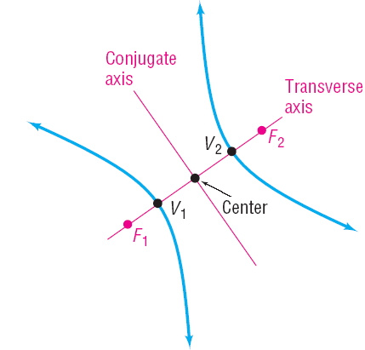
Copyright © 2012 Pearson Education, Inc. Publishing as Prentice Hall.

Slide 3
Copyright © 2012 Pearson Education, Inc. Publishing as Prentice Hall.

Slide 4

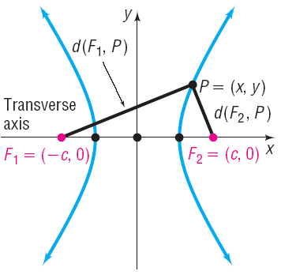
Copyright © 2012 Pearson Education, Inc. Publishing as Prentice Hall.

Slide 5
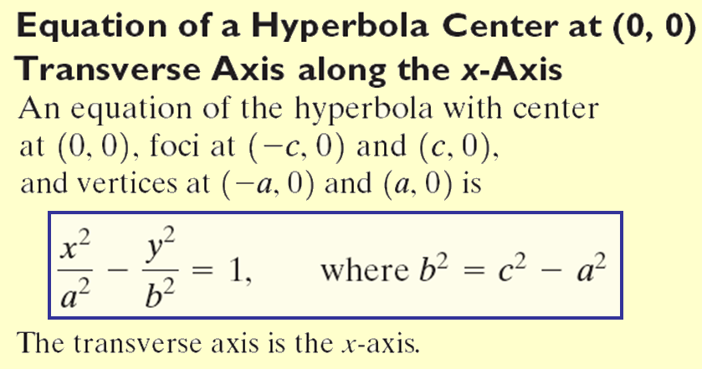
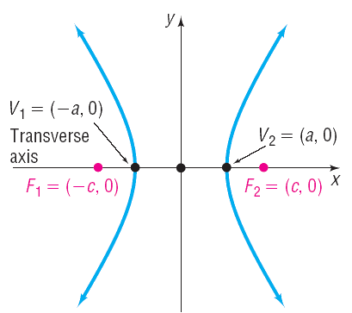
Copyright © 2012 Pearson Education, Inc. Publishing as Prentice Hall.

Slide 6



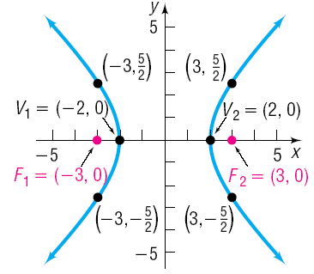
Finding an equation of the hyperbola with center at the origin, one focus at (3, 0), and one vertex at (–2, 0). Graph the equation.
Distance from center to focus is c = 3
Distance from center to vertex is a = 2.
Copyright © 2012 Pearson Education, Inc. Publishing as Prentice Hall.

Slide 7
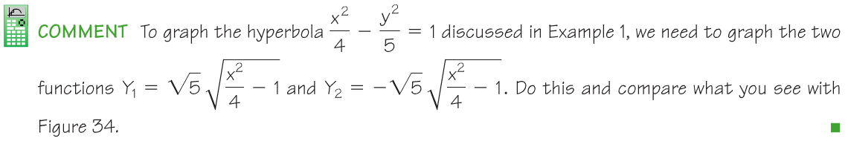

Copyright © 2012 Pearson Education, Inc. Publishing as Prentice Hall.

Slide 8
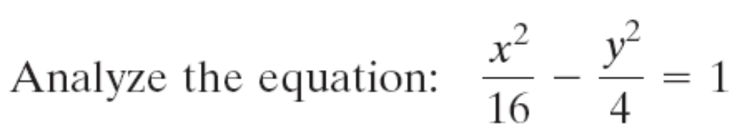

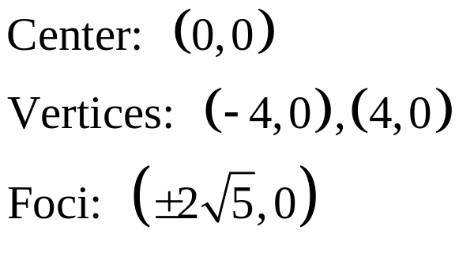
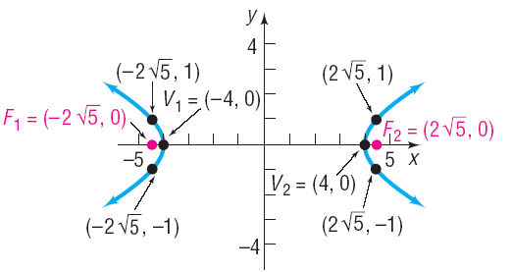
Copyright © 2012 Pearson Education, Inc. Publishing as Prentice Hall.

Slide 9
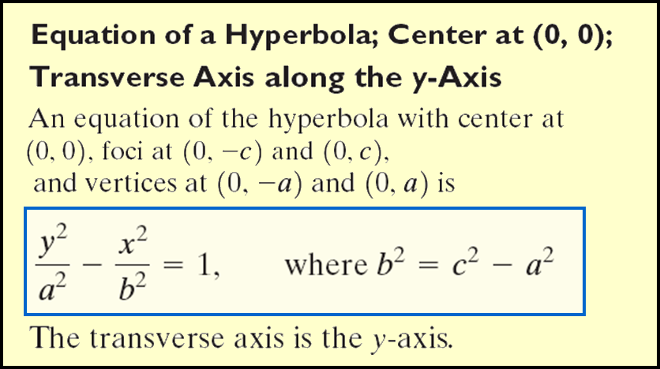
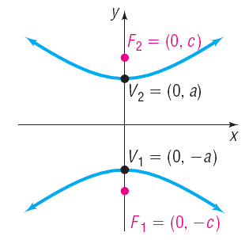
Copyright © 2012 Pearson Education, Inc. Publishing as Prentice Hall.

Slide 10



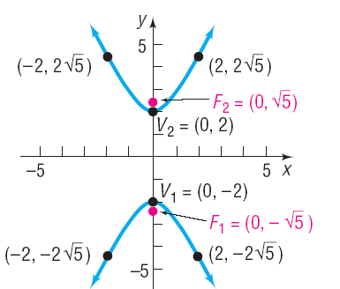
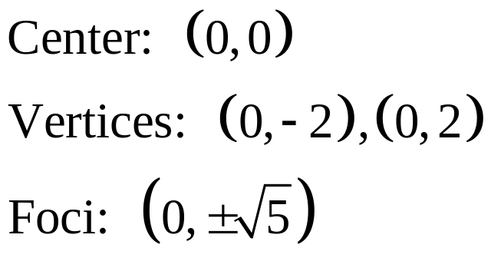
Copyright © 2012 Pearson Education, Inc. Publishing as Prentice Hall.

Slide 11


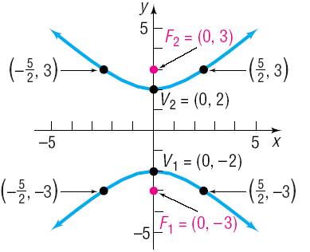


Find an equation of the hyperbola having one vertex at (0, 2) and foci at (0, –3) and (0, 3). Graph the equation.
Looking at the points given we see that the center is at (0,0) and the transverse axis is along the y-axis.
Copyright © 2012 Pearson Education, Inc. Publishing as Prentice Hall.

Slide 12
Copyright © 2012 Pearson Education, Inc. Publishing as Prentice Hall.

Slide 13
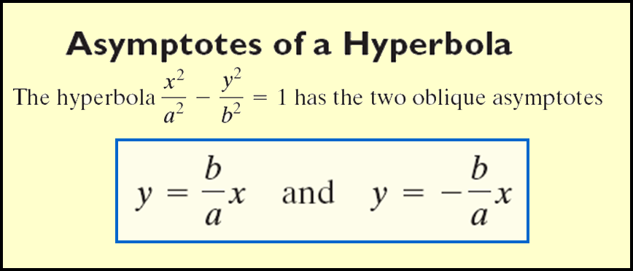
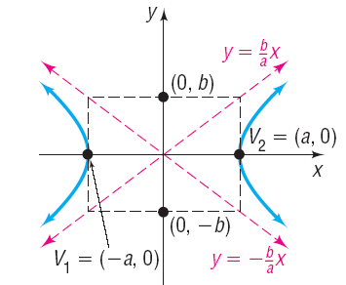
Copyright © 2012 Pearson Education, Inc. Publishing as Prentice Hall.

Slide 14
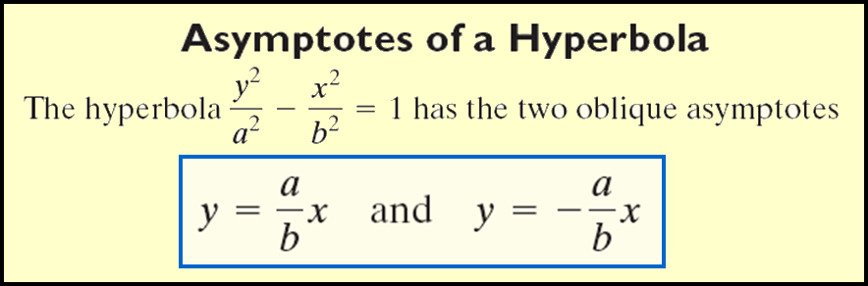
Copyright © 2012 Pearson Education, Inc. Publishing as Prentice Hall.

Slide 15
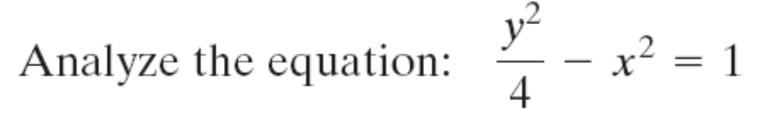
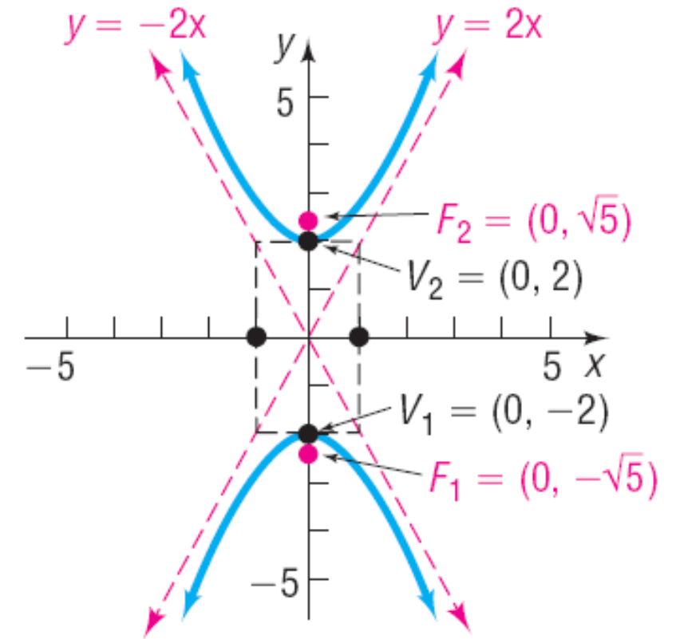


Since the y² term is positive, the transverse axis is along the y-axis.
Copyright © 2012 Pearson Education, Inc. Publishing as Prentice Hall.

Slide 16



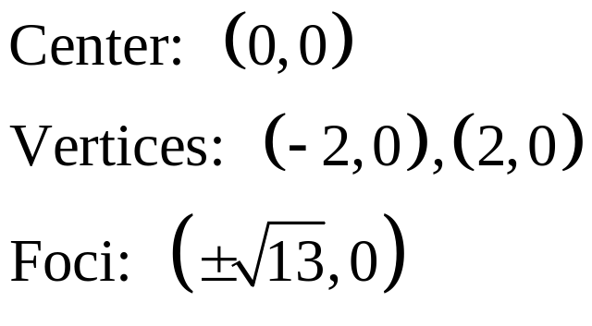
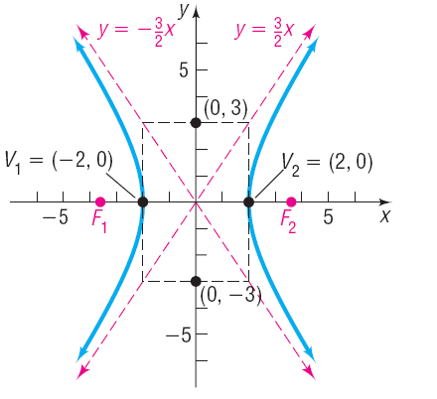

Asymptotes:
Copyright © 2012 Pearson Education, Inc. Publishing as Prentice Hall.

Slide 17
Copyright © 2012 Pearson Education, Inc. Publishing as Prentice Hall.

Slide 18
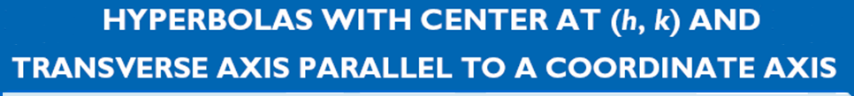
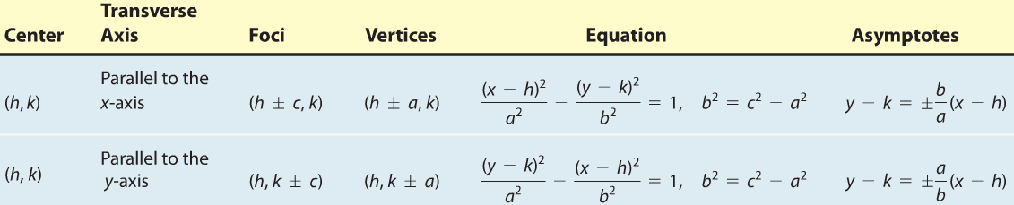
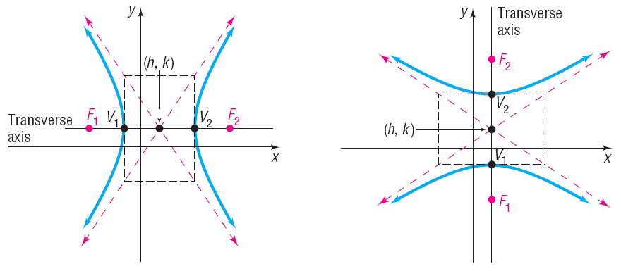
Copyright © 2012 Pearson Education, Inc. Publishing as Prentice Hall.

Slide 19


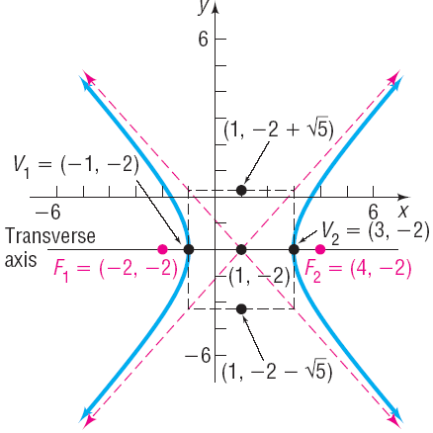


Find an equation for the hyperbola with center at (1, –2), one focus at (4, –2), and one vertex at (3, –2). Graph the equation by hand.
Center, focus and vertex are on y = –2 so tranvserse axis is parallel to x-axis.
Distance from center to a focus is c = 3
Distance from center to a vertex is a = 2
Copyright © 2012 Pearson Education, Inc. Publishing as Prentice Hall.

Slide 20


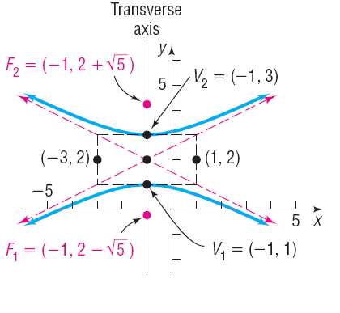

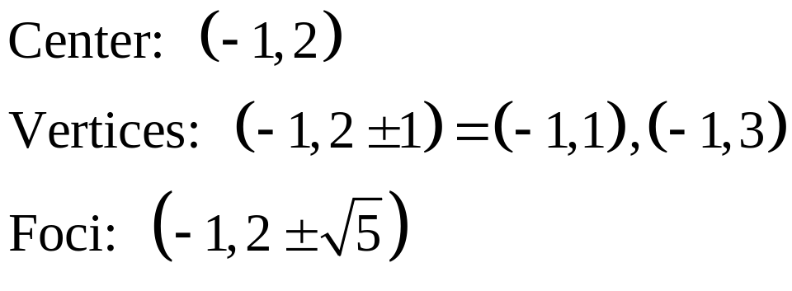
Copyright © 2012 Pearson Education, Inc. Publishing as Prentice Hall.

Slide 21
Copyright © 2012 Pearson Education, Inc. Publishing as Prentice Hall.

Slide 22
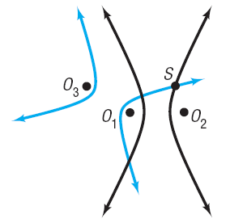
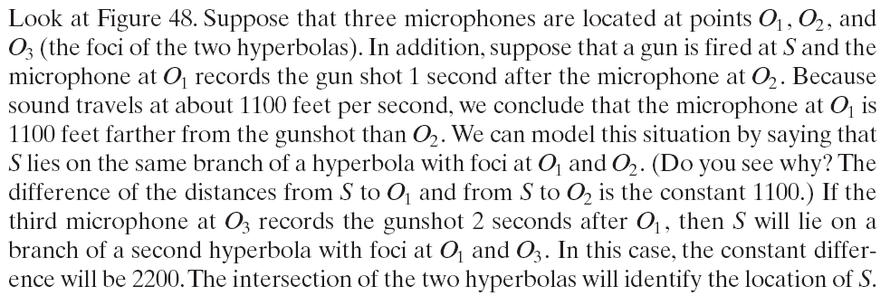
Copyright © 2012 Pearson Education, Inc. Publishing as Prentice Hall.

Slide 23

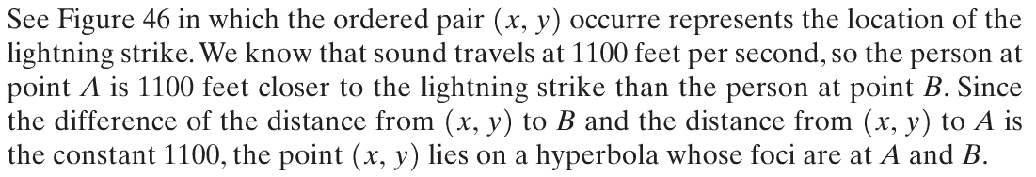
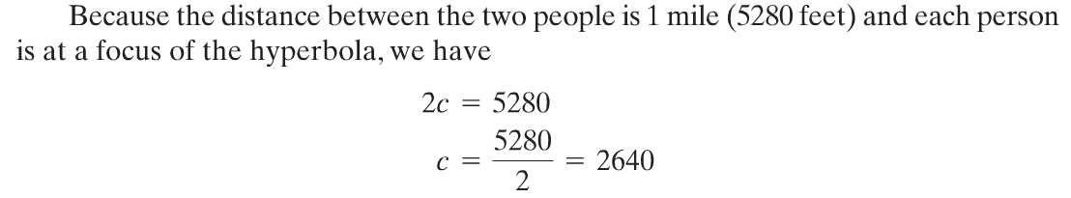
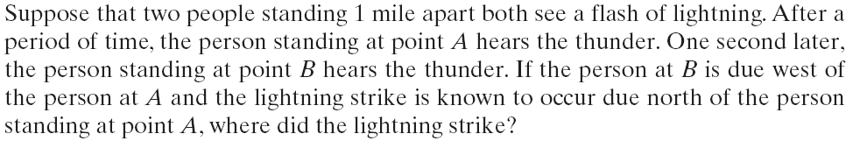
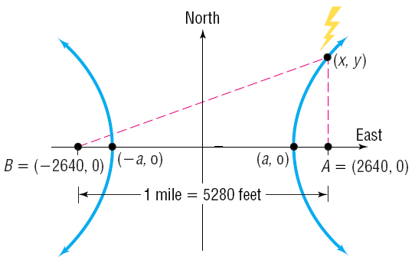






Copyright © 2012 Pearson Education, Inc. Publishing as Prentice Hall.

